Slide 1
Hierarchical Clustering in Clinical Research —— Using Venous Thrombosis as an example
EPI-OMICs-Meeting
Keyong Deng
Department of Clinical Epidemiology

Slide 2
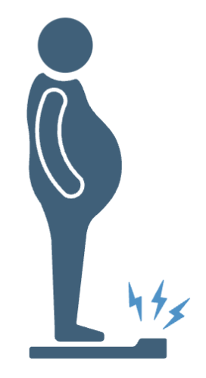
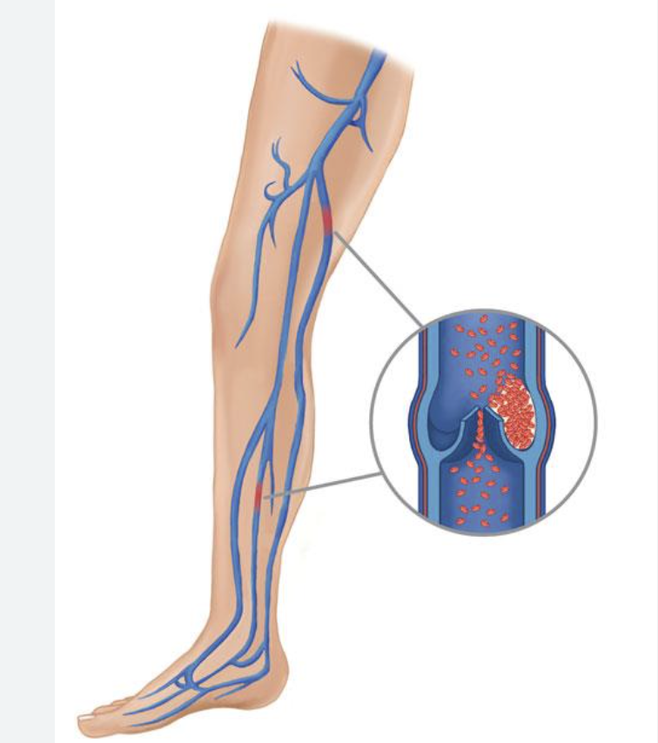
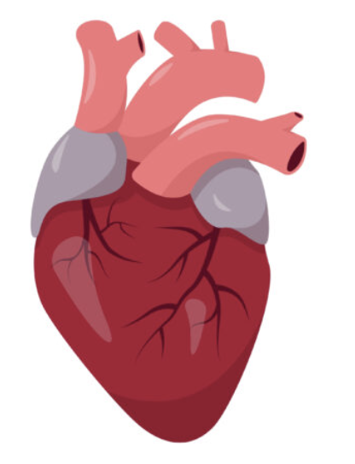
Background
Most of the diseases are multifactorial, caused by a combination of various risk factors
Transient
surgery
Provoking factors
long-distance travel (>10 hours)
immobilization (> 3 days)
within last 2 months
Unprovoking factors
Persistent
Provoking factors
DVT, VTE
Active cancer / severe inflammatory diseases / …
VTE Patients, but without provoking factors

Slide 3

The issues of current risk stratification
Not all patients benefit from the same treatment
DOACs / VKs
Not all patients have the same clinical outcome
recurrent VTE
bleeding
prognosis
death
…
Is there any new phenotype indicating different risks of clinical complications/outcomes for the VTE patients?

Slide 4
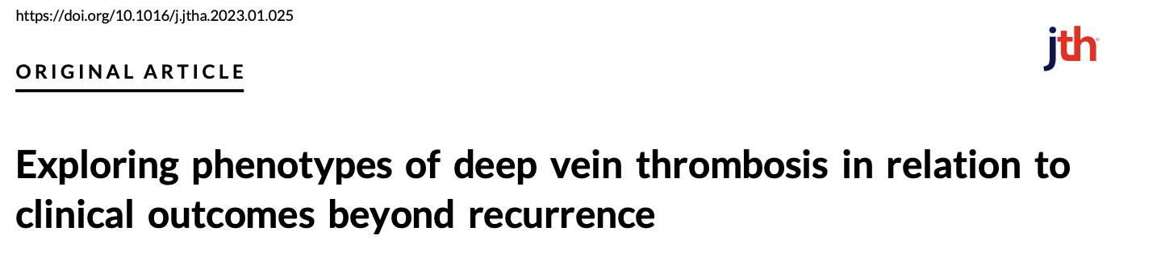
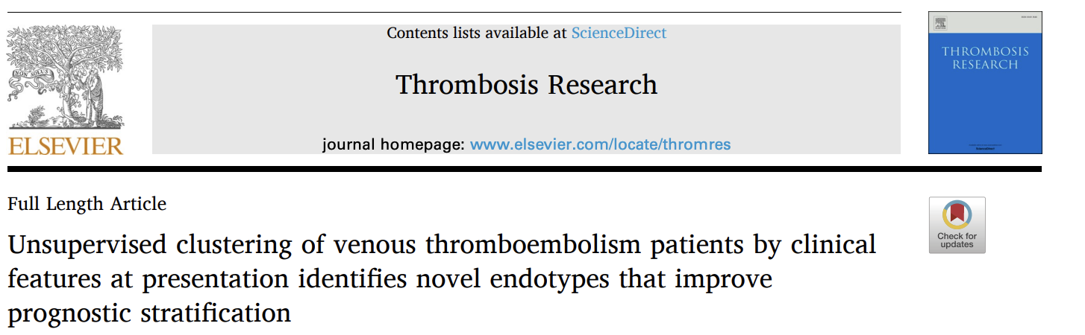
Different Scenarios
Healthy Controls
Follow-up
High risk group / incidence disease
Pre-disease
Cases
Follow-up
Disease Onset
Recurrent events / Mortality / Prognosis

Slide 5
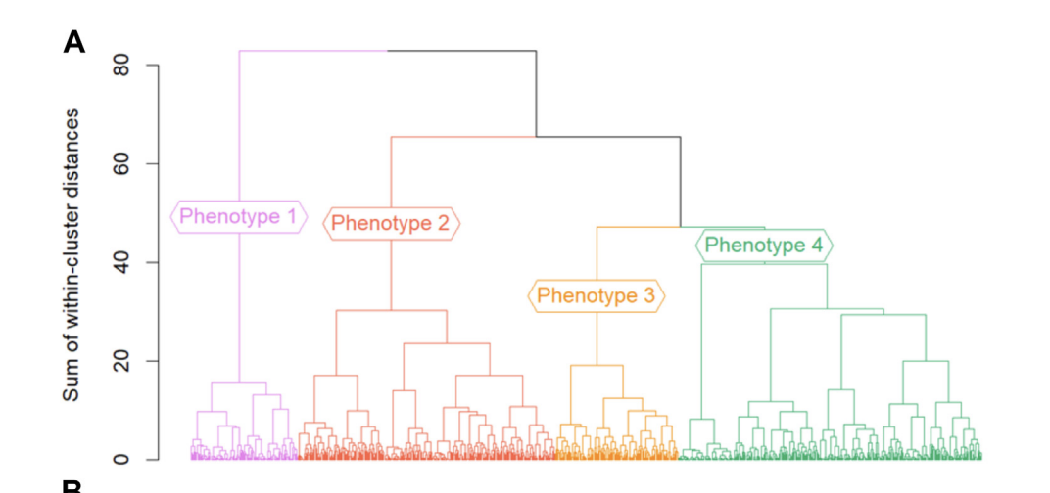

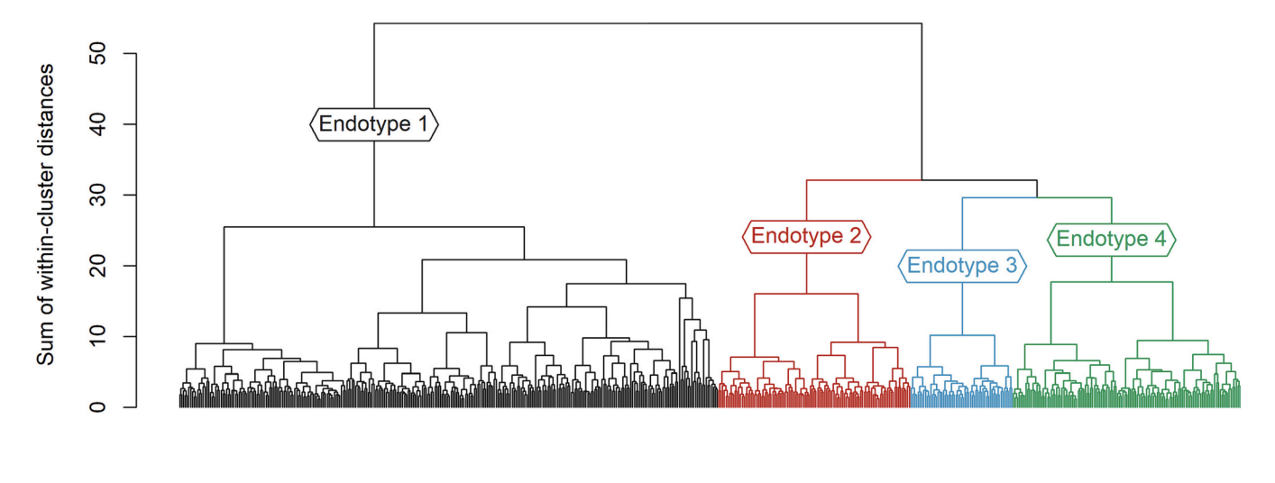
The main idea
825 Deep vein thrombosis patients
Hierarchical clustering applied to 23 variables (variables are mainly about risk factors)
693 Acute venous thrombosis patients
Hierarchical clustering applied to 58 variables (clinical and laboratory variables : continuous and dichotomous)

Slide 6
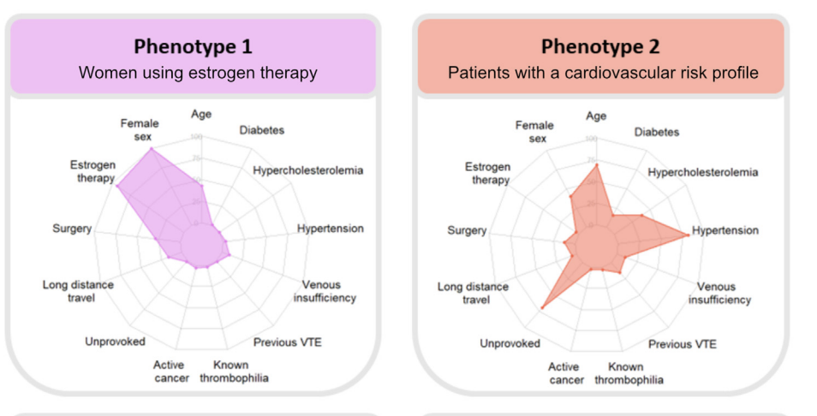
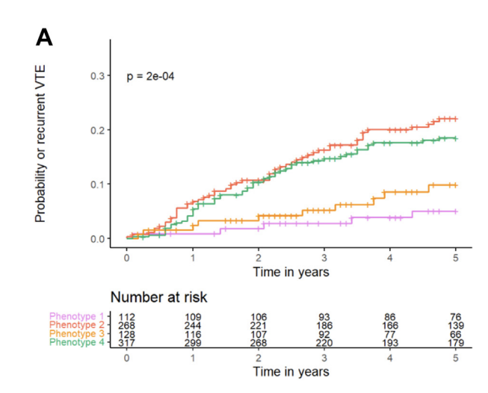
The main idea
After identifying the different clusters for individuals
Describe characteristic of different clusters
Cluster1
Cluster3
Cluster2
Cluster4
Clinical Outcomes
Hazard ratio for recurrent VTE (compared within different clusters)
Omics profiles
Differences in molecular traits among clusters

Slide 7
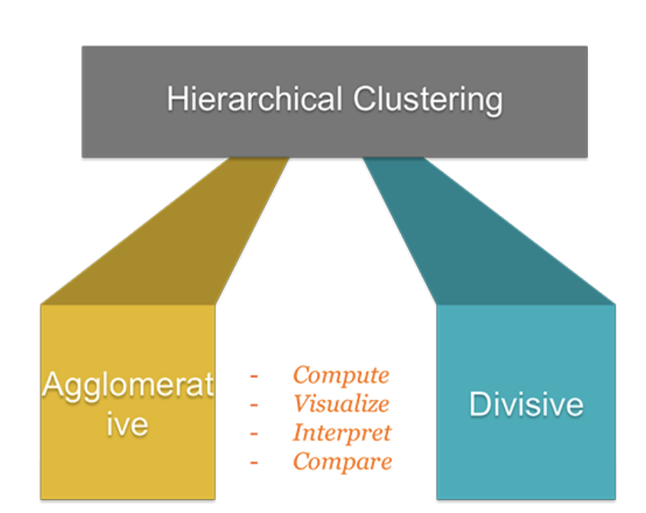
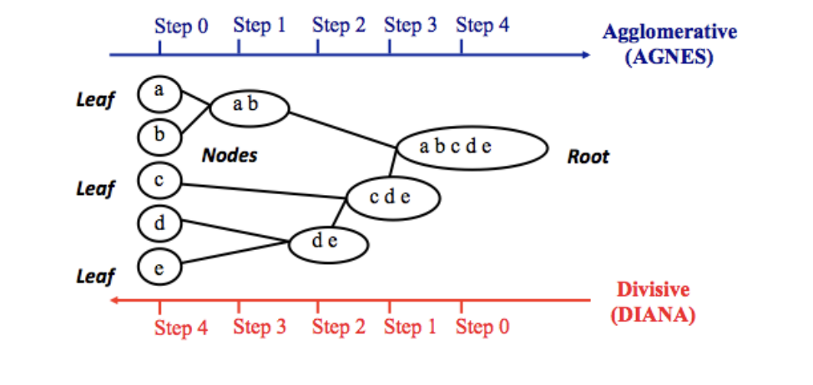
What’s hierarchical clustering?
It is a method for grouping objects based on their similarity, in contrast to Kmeans clustering, hierarchical clustering doesn’t require to pre-specify the number of clusters.
Two types:
Agglomerative clustering
each observation is considered as a cluster, then the most similar clusters are merged
Divisive clustering
all objects are included in one cluster, most different cluster are successively divided

Slide 8
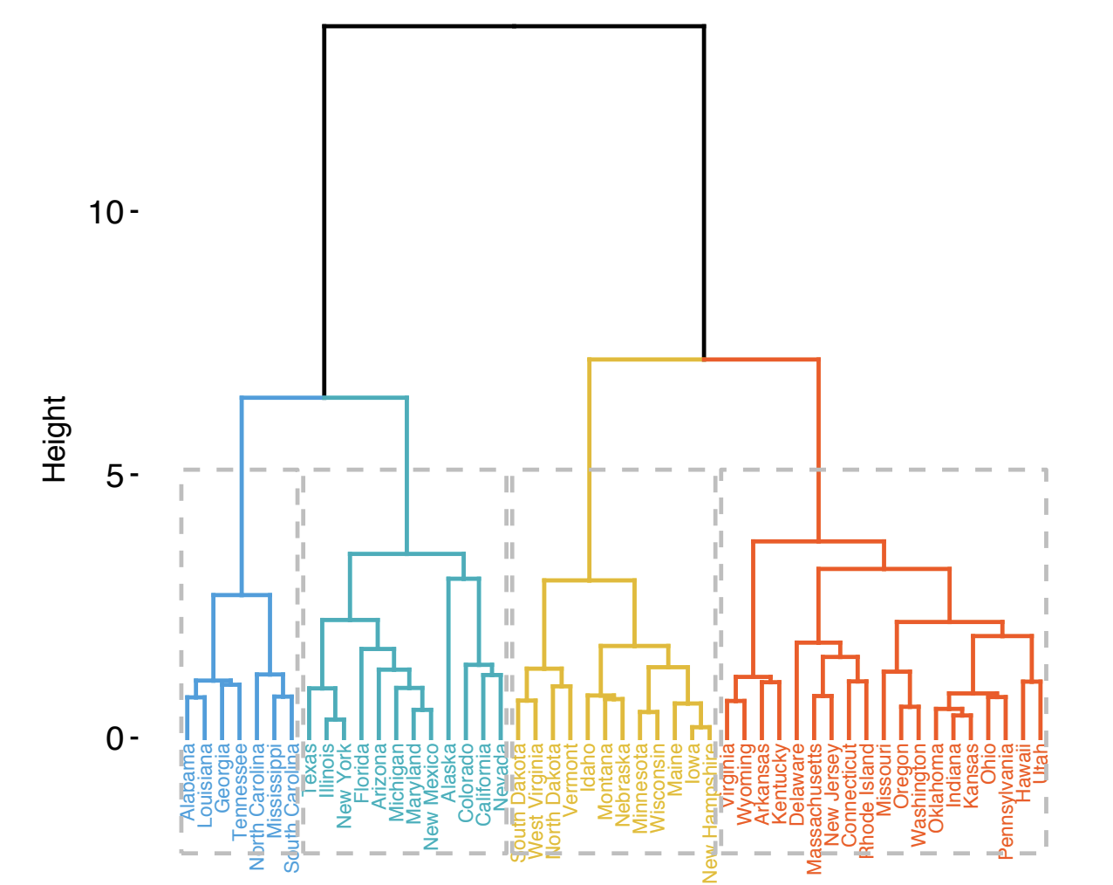
Key Terms
Dendrogram: A representation of the records and the hierarchy of clusters
Distance: A measure of how close one record is to another
Dissimilarity: A measure of how close one cluster is to another
The leaves of the tree correspond to the records. The length of the branch in the tree
indicates the degree of dissimilarity between corresponding clusters.

Slide 9
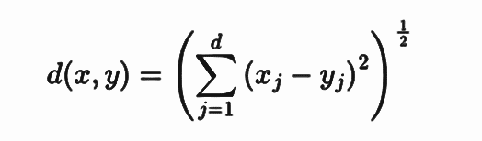
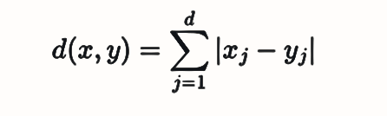
Steps to do hierarchical clustering
Preparing the data (computing distance between objects)
Euclidean distance
Manhattan distance
Computing dissimilarity matrix between every pair of objects
Using Linkage function to group objects into cluster tree, based on distance information
Clusters that are in close proximity are linked together
4. Determining where to cut the tree in dendrogram into clusters
methods to compute distance between clusters
“complete”, ”single”, “average” , “Ward”

Slide 10
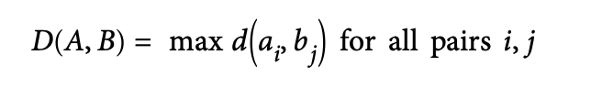
Different methods to measure dissimilarity
complete-linkage method: It tends to produce more compact cluster
average-linkage method:
The distance between two clusters is defined as the average distance between the elements in cluster 1 and the elements in cluster 2.
ward-linkage method:
It minimizes the total within-cluster variance.
single-linkage method:
opposite to complete-linkage method, it tends to produce long clusters
Ward-linkage and complete-linkage method are generally preferred

Slide 11
Other things to consider
Hierarchical clustering doesn’t tell how many clusters there are, or where to cut the dendrogram to form clusters
The optimal number of cluster is subjective and depends on the method used for measuring similarities
simple and popular solution : inspect the dendrogram produced using hierarchical clustering to see if there is a suggested number of cluster
elbow method:
This method chooses a number of clusters when within-cluster sum of square (WSS) is minimized
average silhouette method
It shows how well each object lies within the cluster, the higher value indicates better clustering

Slide 12
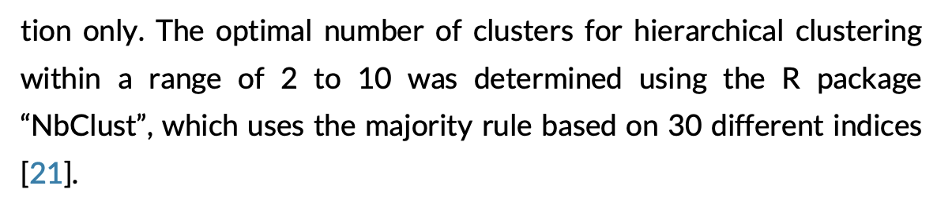
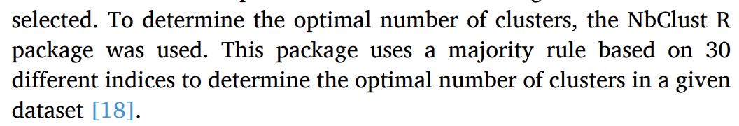
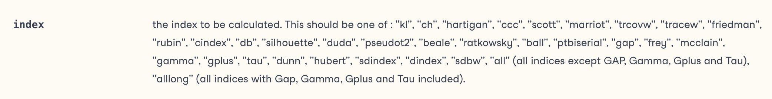
Nbclust() function, can help determine the optimal number of clusters , based on 30 indices

Slide 13
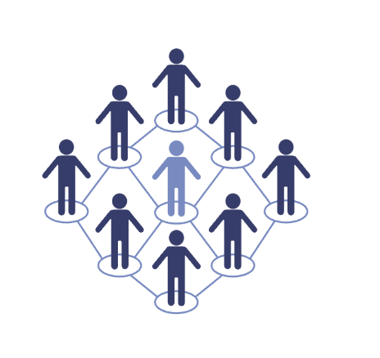
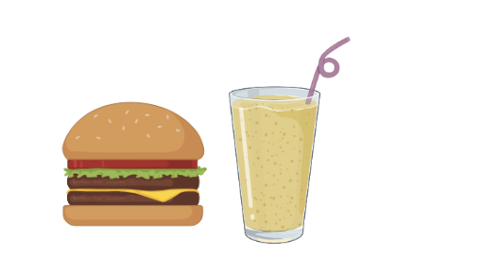
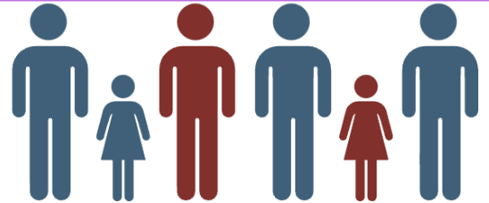
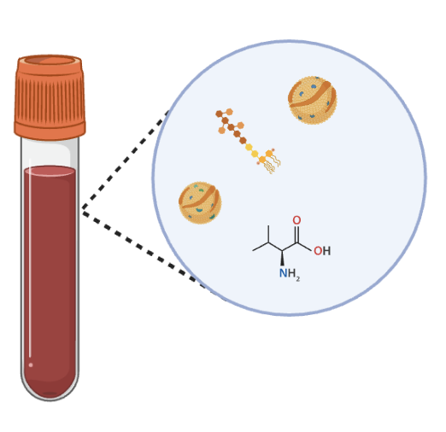
Combined with our “Own” Work
(NEO Study)
Follow up
Meal Challenge
hierarchical clustering applied to metabolites
incident disease
Change in Blood Metabolites profiles
Fasting
Postprandial

Slide 14
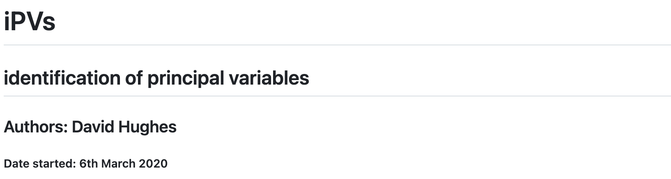
Metabolites Data
New problem ? (different from clinical characteristic)
We have 200 metabolites level for each time point (fasting, postprandial), but
most of these metabolites are highly correlated
High-dimensional data -> Select the independent variables / dimension reduction
https://github.com/hughesevoanth/iPVs

Slide 15
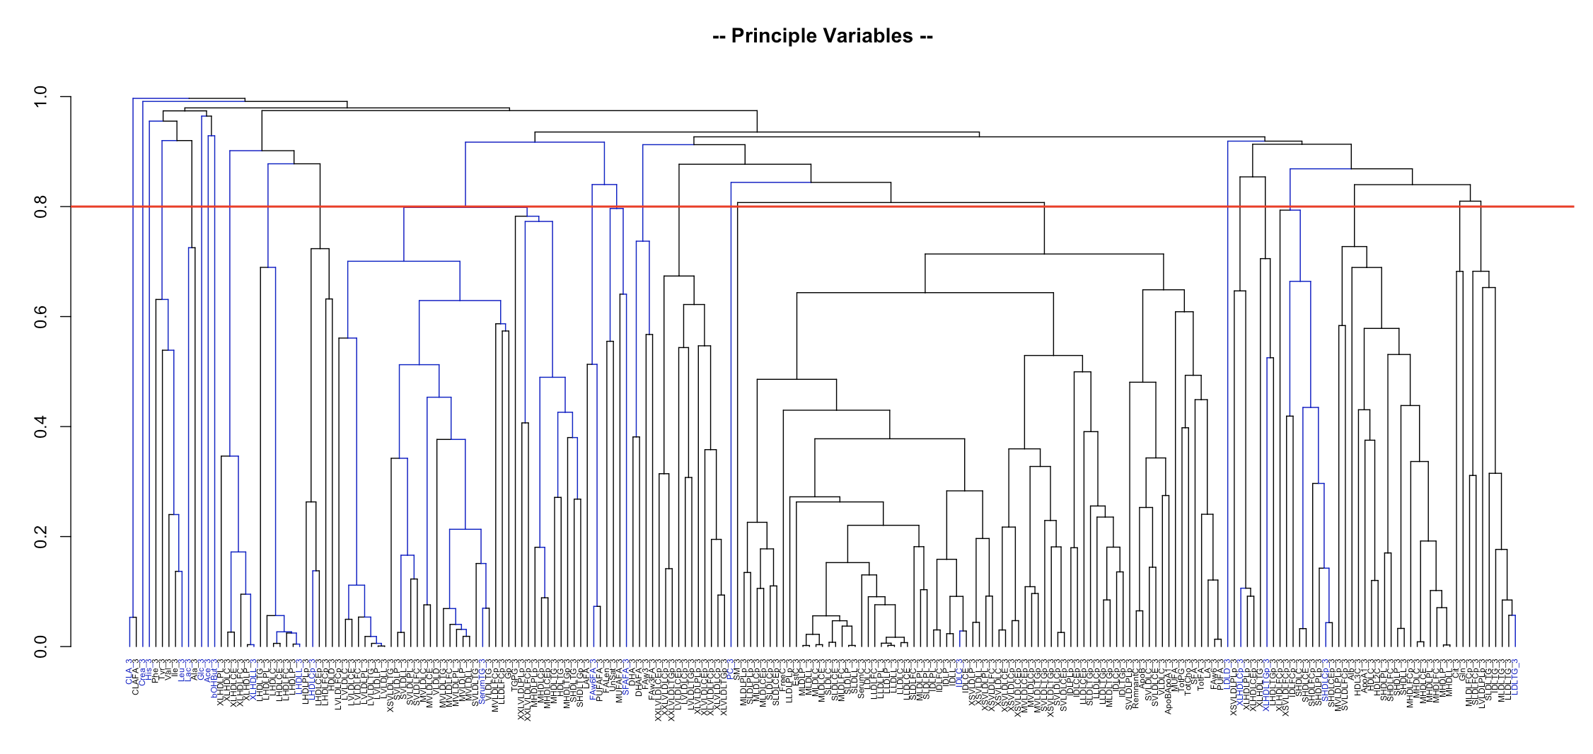
Results
Using hierarchical clustering method, the first step is to reduce the number of metabolites, keep the independent ones.
Based on these independent metabolites -> The number of clusters -> classify individuals

Slide 16
Thanks!
Keyong Deng
Department of Clinical Epidemiology

